Slide 1

VR Monkeys
By: Ivan Nieto
Kitt Phi
Jeffrey Lansford
Jonathon Ayavar

Slide 2
Project overview
Follow a set of clues to find a missing or kidnapped person.
Game is set in a VR world.
All game interactions are made with the VR headset.

Slide 3

Key architectural drivers
All our objects need to interact/communicate with each other.
Objects are divided into hierarchies.

Slide 4
Architectural style choices:
Peer to Peer – Game objects can request actions from others. Game objects are independent.
Publish and subscribe – Physics and object interaction.

Slide 5
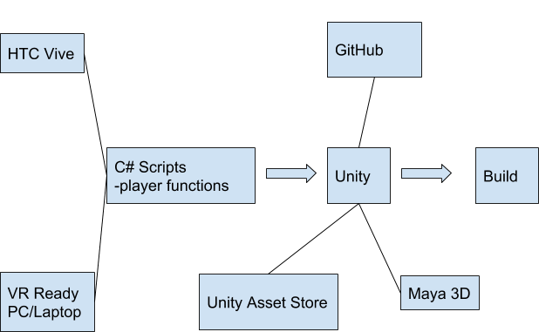
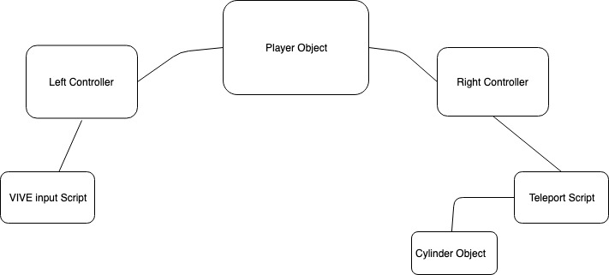
Our architecture - PEER TO PEER
Lots of prototyping/testing
Incremental programming

Slide 6
Conclusion:
Architecture Style: Peer to Peer/Publish and subscribe
Issues/Risks: Moving assets from program to program and making them work on each program.
What clues should we have?
How hard should the game be?

